Slide 1
Comparisons

Slide 2
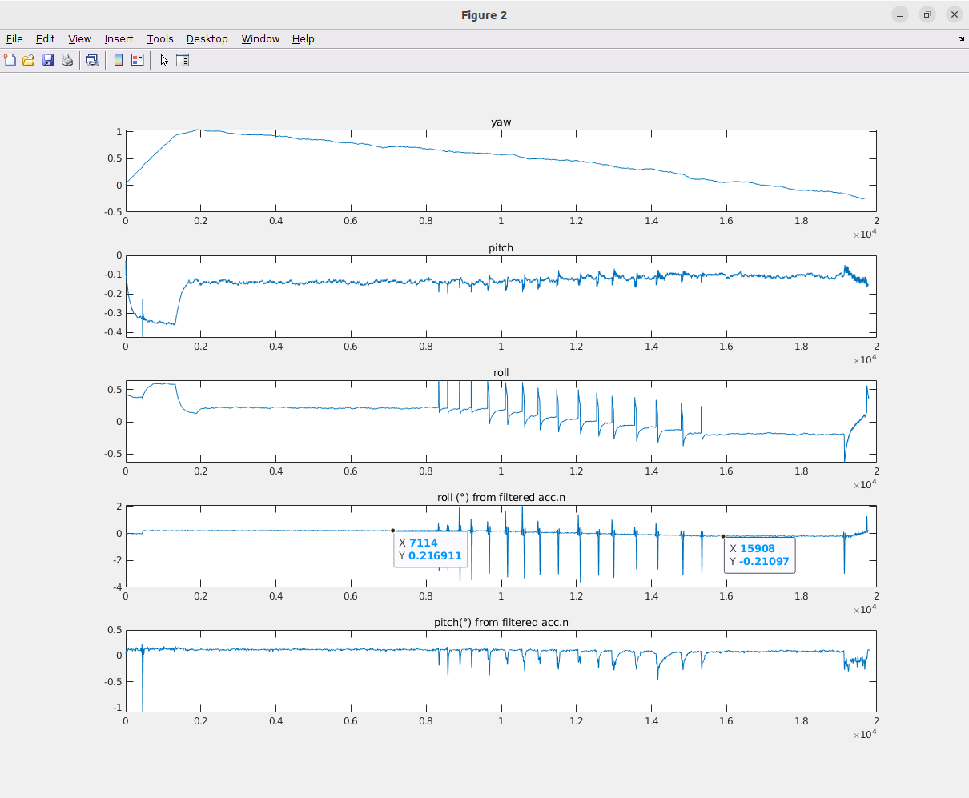
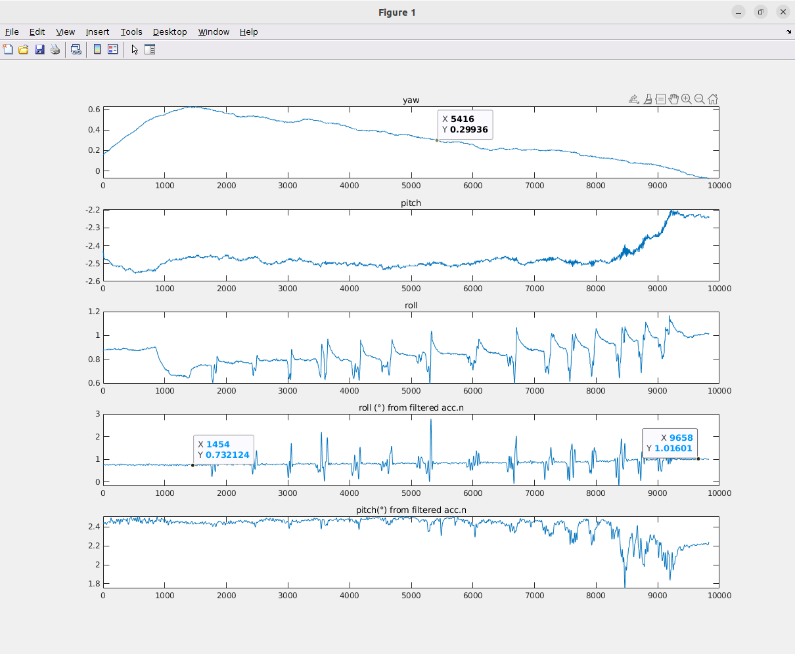
No weight (Prev Vs Lab)
Previous data (≈ 0.4° variation) Lab measured data (≈ 0.3° variation)

Slide 3
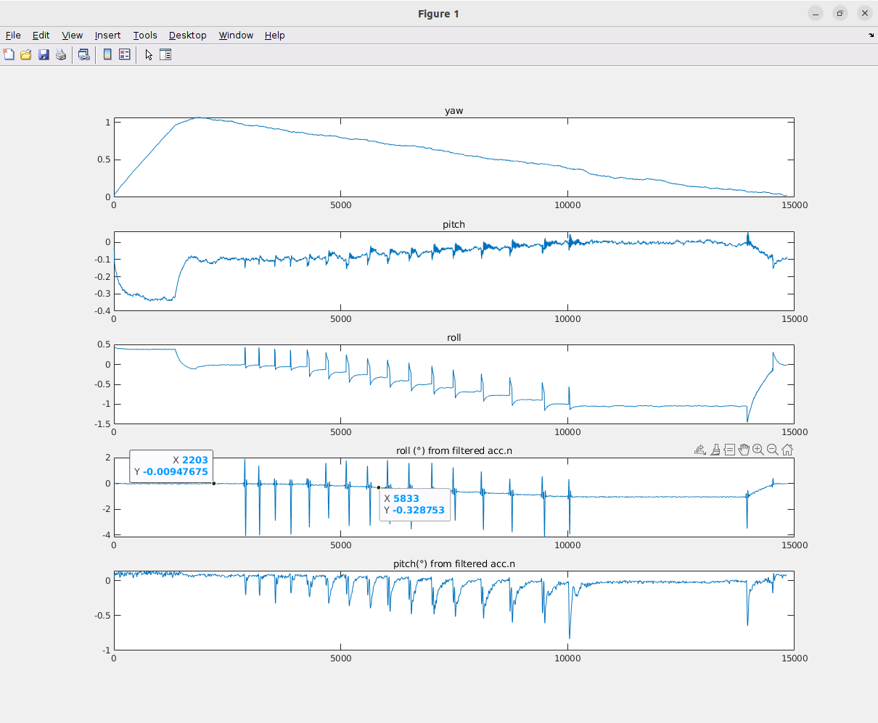
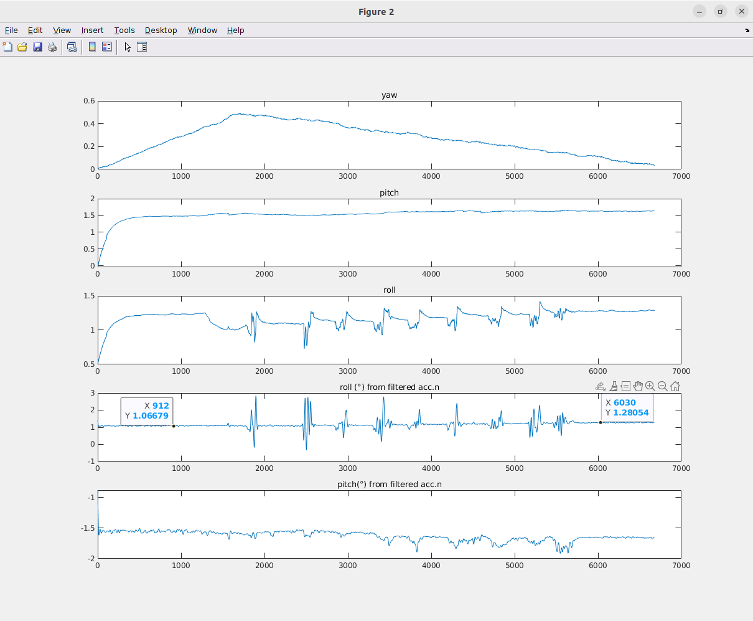
Full Weight (Prev Vs Lab)
Previous data (≈ 0.3° variation) Lab measured data (≈ 0.2° variation)

Slide 4
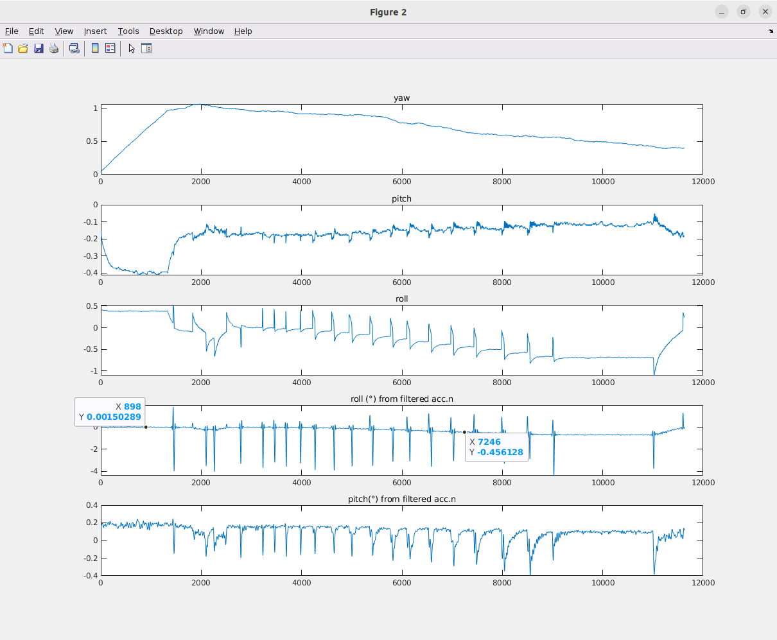
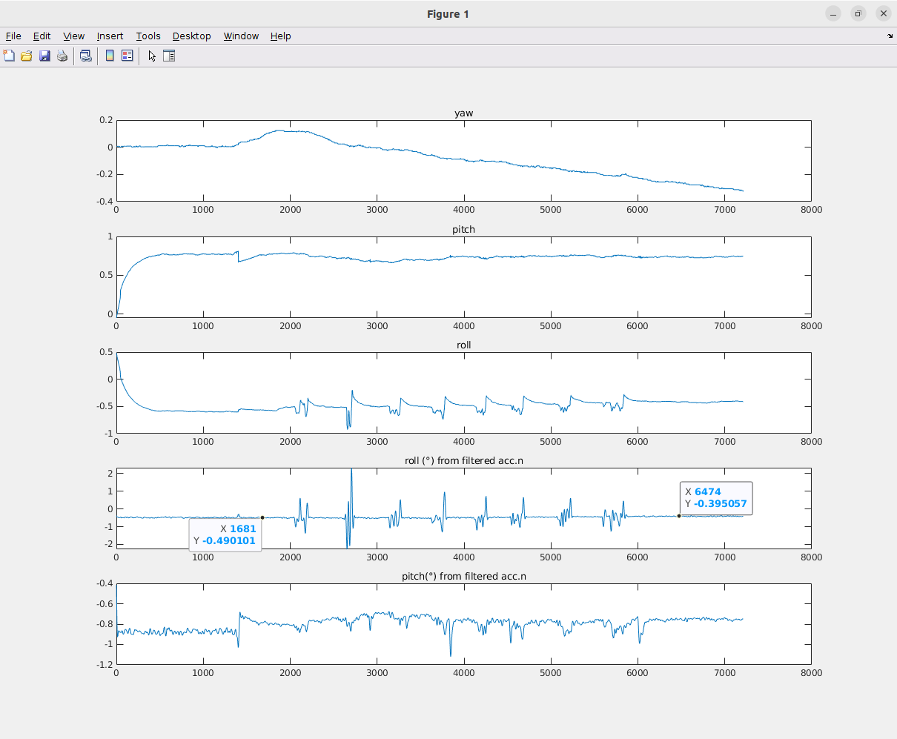
Half Weight (Prev Vs Lab)
Previous data (≈ 0.4° variation) Lab measured data (≈ 0.1° variation)

Slide 5
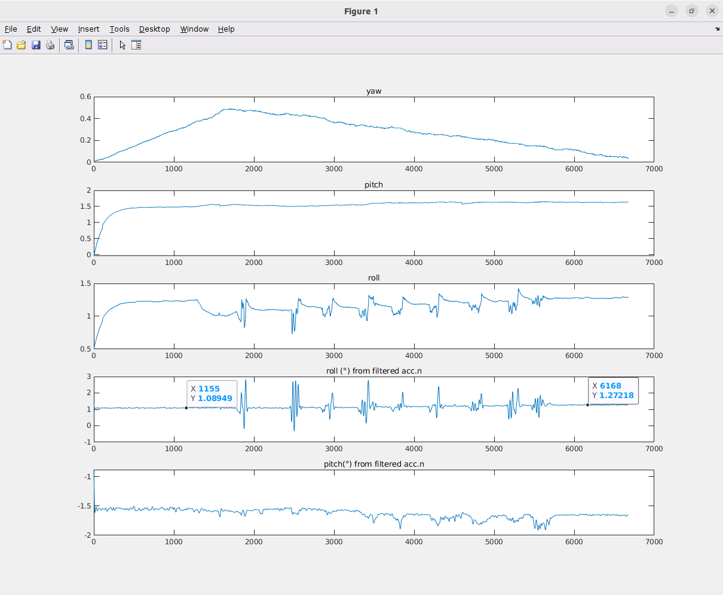
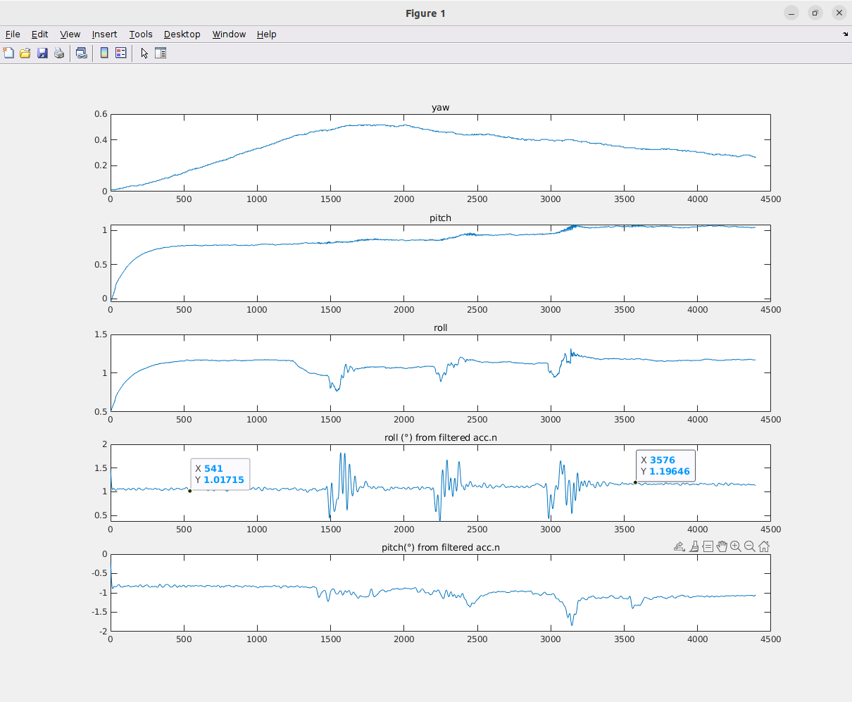
Full Weight (Lab Vs Lab)
From 320 mm to 1120 mm (≈ 0.2° variation) From 1260 mm to 1560 mm (≈ 0.2° variation)

Slide 6
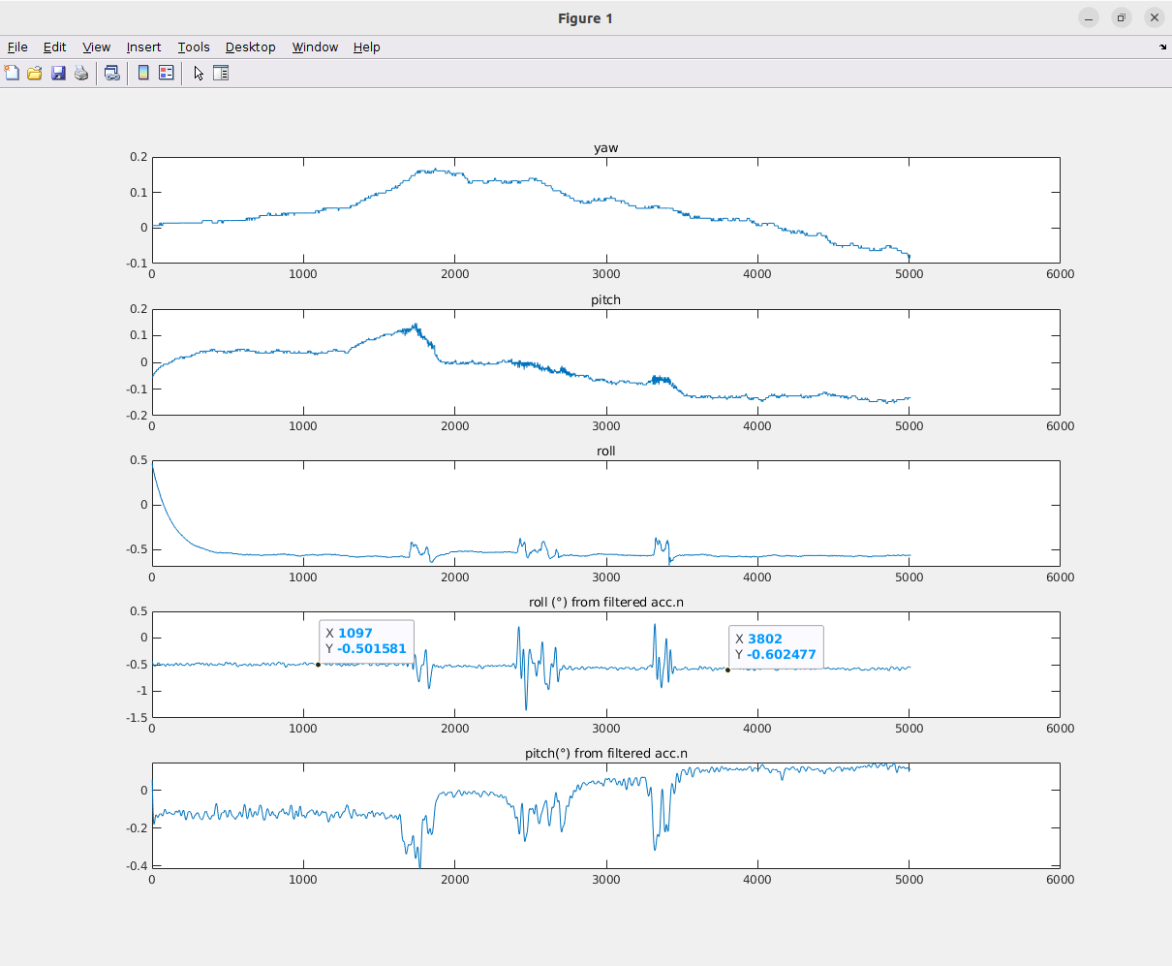
Half Weight (Lab Vs Lab)
From 320 mm to 1120 mm (≈ 0.1° variation) From 1560 mm to 1260 mm (≈ 0.1° variation)

